Slide 1

PYTHON PROGRAMMING
Regular Expressions
A regular expression is a sequence of characters that define a search pattern, mainly for use in pattern matching with strings, or string matching, i.e. “find and replace” like operations.
Dr Venkat Raju

Slide 2
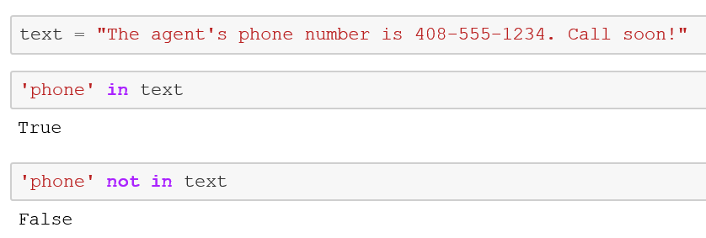
A regular expression is a sequence of characters that define a pattern.
Regular expressions must be able to filter out any string pattern.
The re module provides full support for regular expressions.

Slide 3
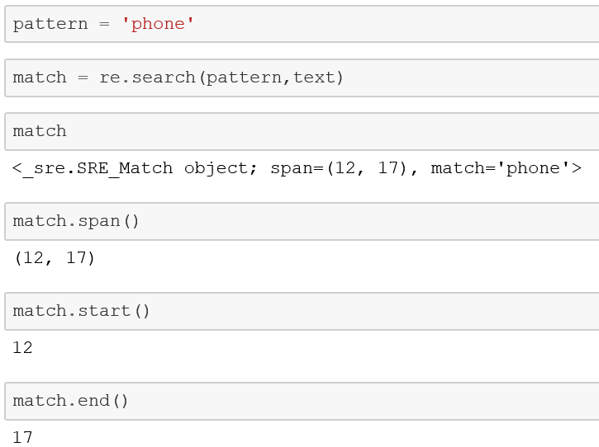
import re
re.search() will take the pattern, scan the text, and then returns a Match object.
If no pattern is found, a None is returned.

Slide 4
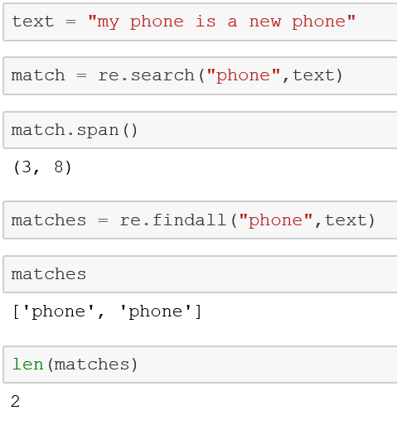
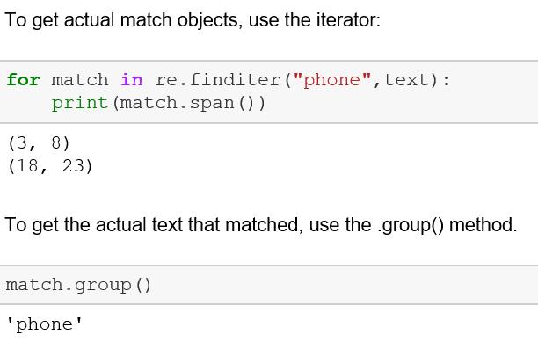

Slide 5
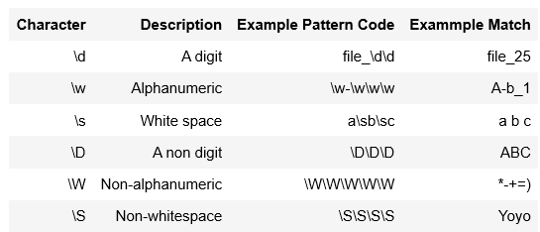
Identifiers for Characters in Patterns
Characters such as a digit or a single string have different codes that represent them.

Slide 6
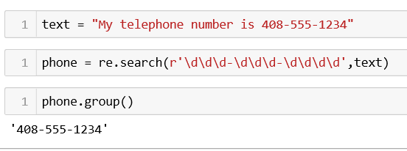
Note: the repetition of \d.

Slide 7
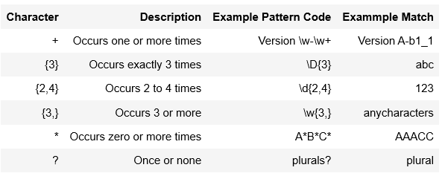

Quantifiers
Specify how many instances of a character/group must be present in the input
for a match to be found

Slide 8
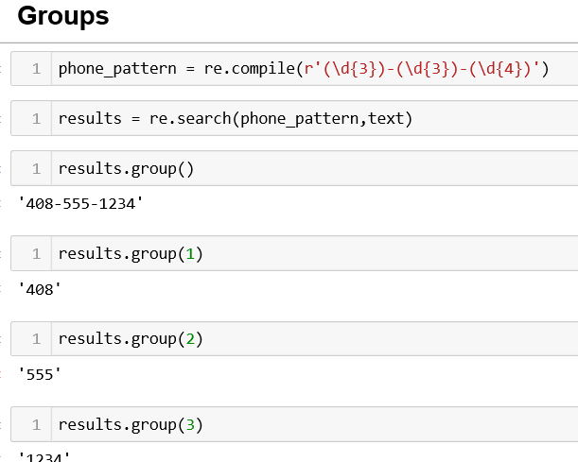
Parts of a regular expression pattern bounded by parenthesis are called groups

Slide 9
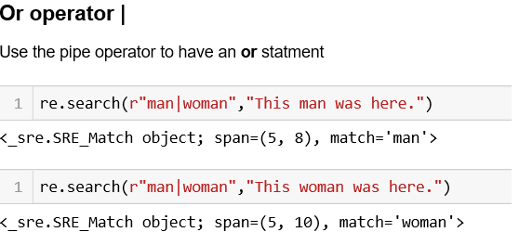

Slide 10
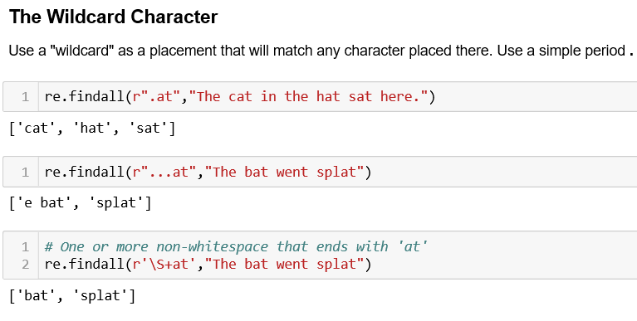

Slide 11
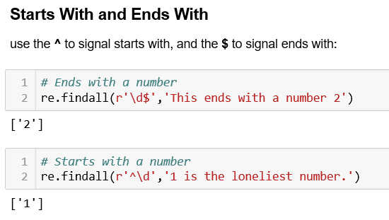

Slide 12
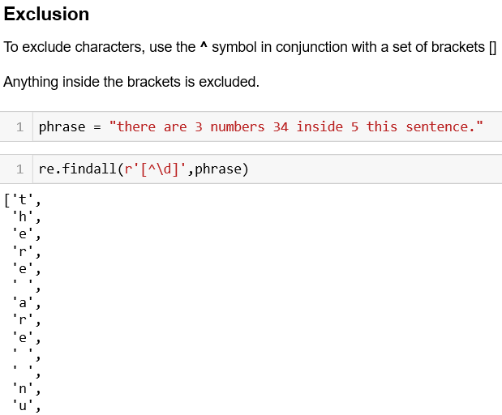

Slide 13
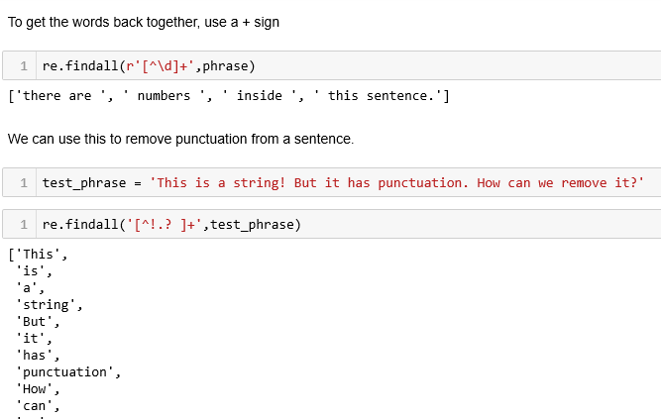

Slide 14
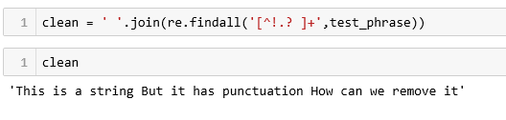
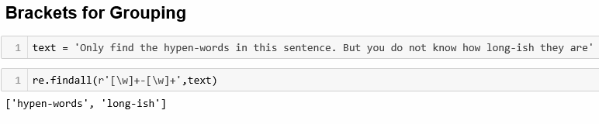

Slide 15
3 What does the function re.match do?
a) matches a pattern at the start of the string
b) matches a pattern at any position in the string
c) such a function does not exist
d) none of the mentioned
1 Which module in Python supports regular expressions?
a) re
b) regex
c) pyregex
d) none
4 What will be the output of the following Python code?
sentence = 'we are humans’
matched = re.match(r'(.*) (.*?) (.*)', sentence) print(matched.groups())
2 Which of the following creates a pattern object?
a) re.create(str)
b) re.regex(str)
c) re.compile(str)
d) re.assemble(str)
a) (‘we’, ‘are’, ‘humans’)
b) (we, are, humans)
c) (‘we’, ‘humans’)
d) ‘we are humans’

Slide 16
5 What will be the output of the following Python code?
sentence = 'horses are fast’
regex = re.compile('(?P<animal>\w+) (?P<verb>\w+) (?P<adjective>\w+)’)
matched = re.search(regex, sentence)
print(matched.groupdict())
a) {‘animal’: ‘horses’, ‘verb’: ‘are’, ‘adjective’: ‘fast’}
b) (‘horses’, ‘are’, ‘fast’)
c) ‘horses are fast’
d) ‘are’

